Slide 1
Week 1: Java Programming for FRC

Slide 2
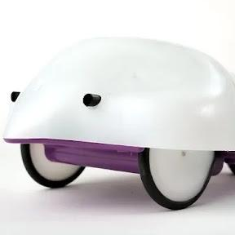
Overview
Introduction
Programming for Robotics
Object Oriented Programming
Java Fundamentals
FRC Programming
  Robot Lifecycle
  Programming Structures
I/O (Teleop) Programming

Slide 3
Introduction
Course Structure
  Six weeks focusing on different areas of programming for FRC
Week 1: Fundamentals of Java and FRC Programming
Week 2: Dashboards and Logging
Week 3: PID Motor Control
Week 4: Swerve Drive
Week 5: Vision and Localization
Week 6: Pathplanner

Slide 4
Introduction
Course Structure
  Six weeks focusing on different areas of programming for FRC
Week 1: Fundamentals of Java and FRC Programming
Week 2: Dashboards and Logging
Week 3: PID Motor Control
Week 4: Swerve Drive
Week 5: Vision and Localization
Week 6: Pathplanner

Slide 5

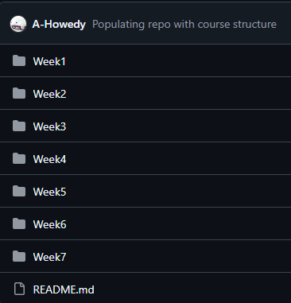
Introduction
Robot is recommended but not required in this course
  Some lessons will be focused on programming and conceptual information
  Some lessons will be more robot focused
  All lessons will be recorded and uploaded to Youtube
  Code and slides will be uploaded to GitHub
    (If you are not familiar with GitHub now would be a great time to ask)
It is a structured course, but its focus is teaching
  Questions and rabbit holes are ideal

Slide 6
Week 1 Goal
Discuss programming for robotics
Introduce fundamentals of Object-Oriented Programming (OOP)
Look at the fundamentals of the Java language
Explain the fundamentals of programming for FRC
  Environment setup (WPILib)
  Third party libraries
Discuss different methods for structuring FRC code
  Timed/Iterative
  Command-based
Build out a basic FRC Teleop code for a Tank Drive robot

Slide 7
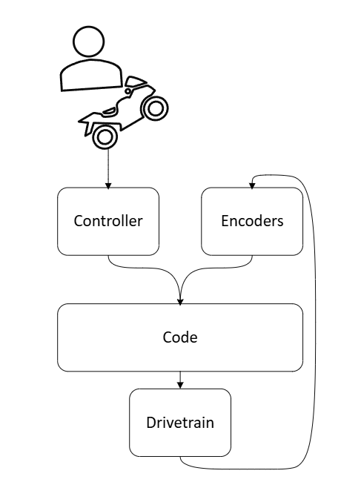
Programming for Robotics
Robots are systems made up of different hardware components
  Motors (Servos, Steppers, DC)
  Sensors (Encoders, Limit Switches, Cameras)
Software combines all these components into a cohesive structure
Typical Robot control loop
  Inputs: Sensors, Controllers, Cameras
  Outputs: Actuators, Drivetrain, Arms, Elevators, Intakes (etc..)
    Outputs can also act as “inputs”

Slide 8
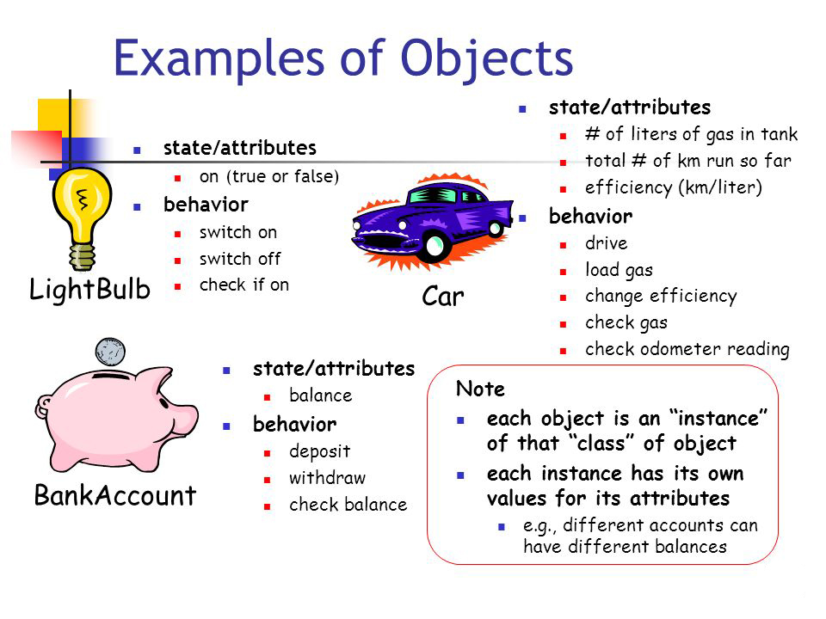
Object Oriented Programming
OOP is a programming paradigm that focuses on the manipulation of objects
  Object is a software entity that bundles:
    Data (What it is)
    Behavior (What it does)
  Keeps code modular and readable

Slide 9
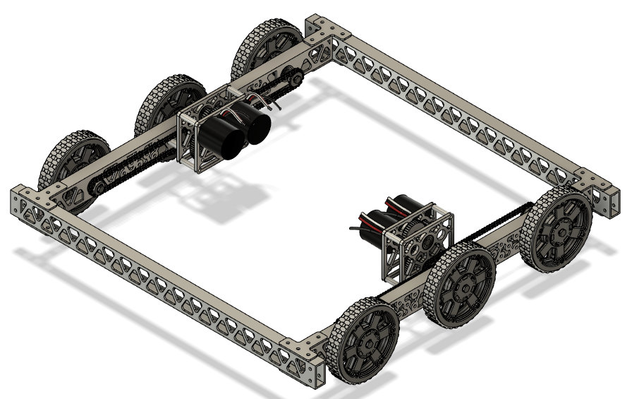
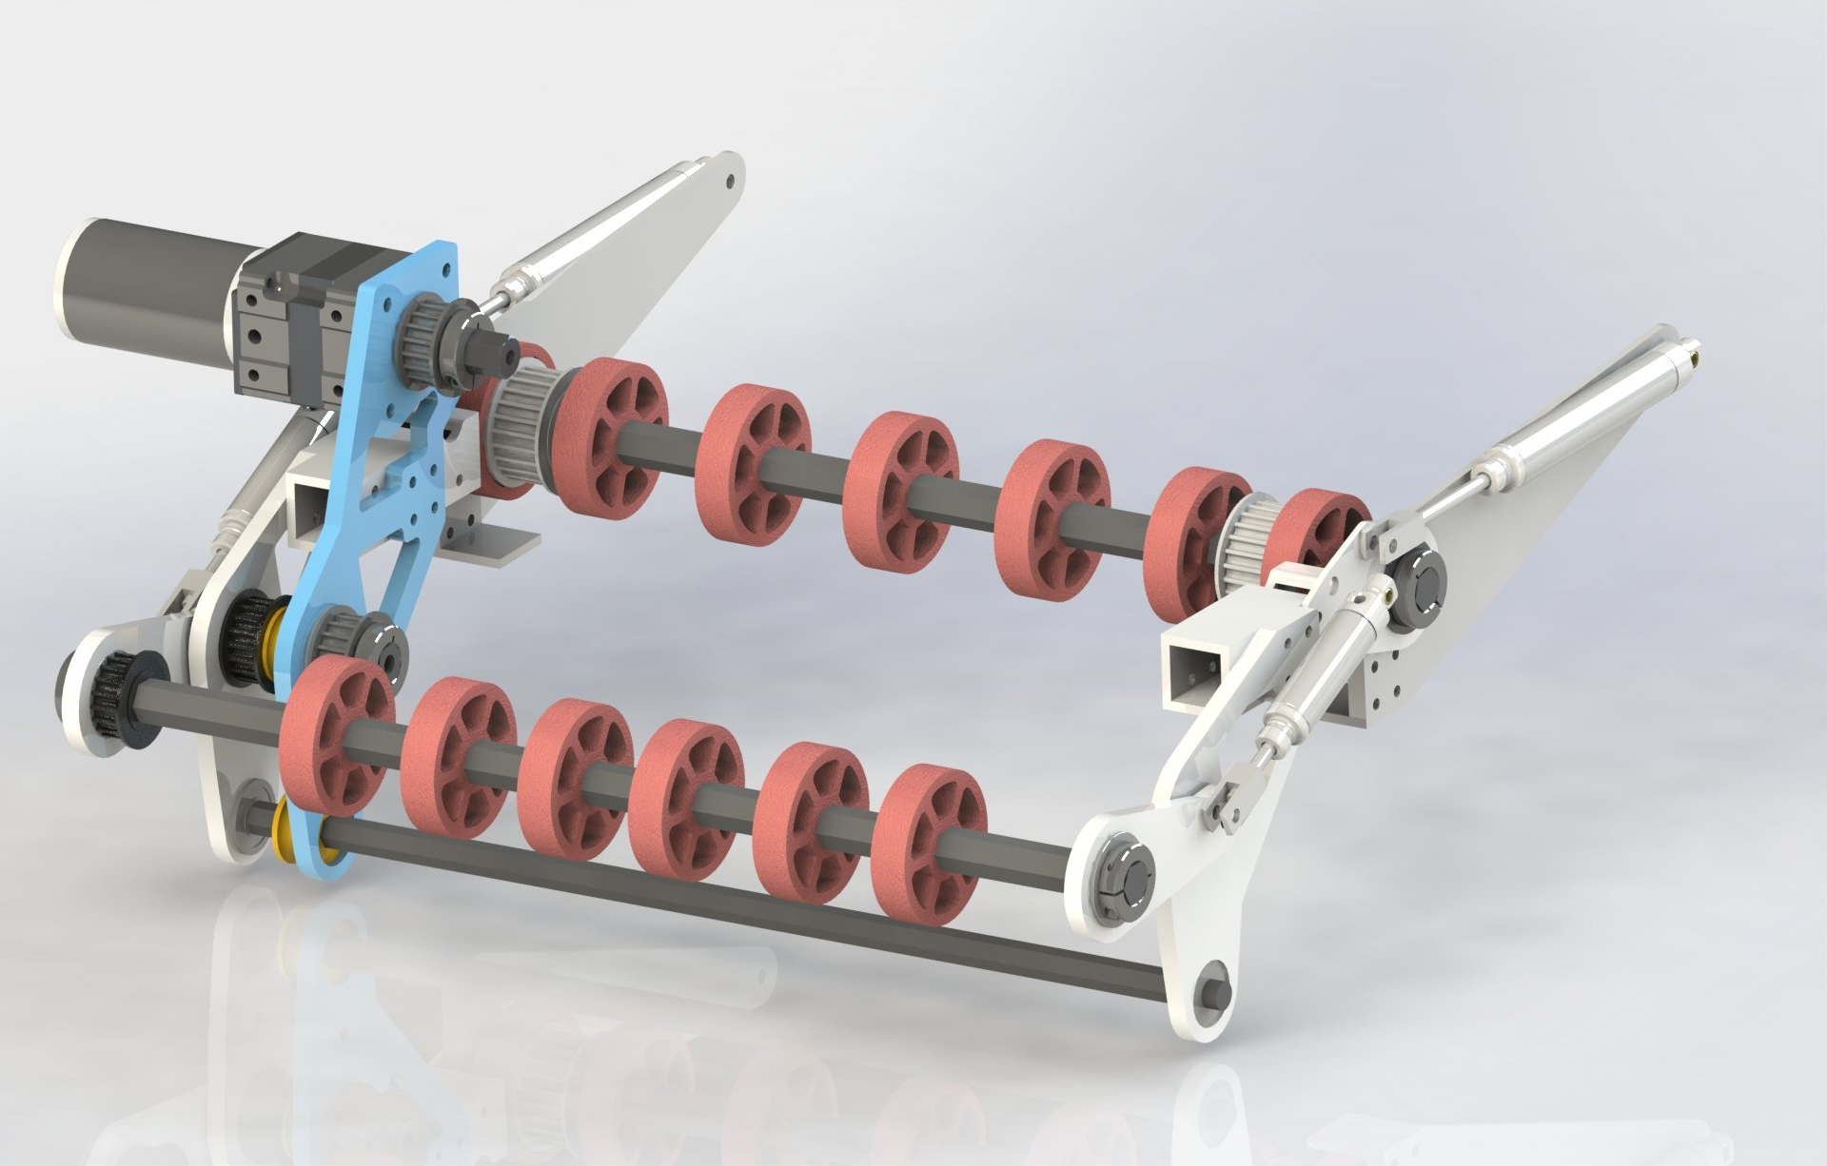
Object Oriented Programming
In Robotics each subsystem is an object
Drivetrain
  Data: Drive Motors, Encoders, Gyroscope
  Behavior: Drive around, Autonomous Path Following
Intake
  Data: Motors, Limit Switches, Servos, Pneumatics
  Behavior: Pull in objects, Spit out objects
Elevator
  Data: Motors, Encoders, Limit Switches, Servos
  Behavior: Move to a position

Slide 10
Object Oriented Programming
Key OOP Concepts
Classes
  The blueprint of an object (MotorController)
Object
  A single instance of that class (leftMotor, rightMotor)
Method
  What the object can do (setSpeed(), stop(), driveForward())
Encapsulation
  Hide messy internals of the class
  You don’t need to know how a motor controller works, just how to program it

Slide 11
Fundamentals of Java
Java is a compiler
  Compiles human readable code into machine language which can be executed by the computer
Java is one of the more popular examples of OOP languages
  Python, C++, C#
  Strongly typed language
Primitive data types
Java basics
Methods and Return Types
Classes

Slide 12
Primitive Types
The non-object building blocks of the Java language
  Store their simple values directly in memory
Foundation for the objects that programmers design and build
  byte: 8-bit integer
  short: 16-bit integer
  int: 32-bit integer
  long: 64-bit integer
  float: 32-bit floating-point number
  double: 64-bit floating-point number
  char: 16-bit character
  boolean: 1-bit value (true/false)

Slide 13
Primitive Types
The non-object building blocks of the Java language
  Store their simple values directly in memory
Foundation for the objects that programmers design and build
  byte: 8-bit integer
  short: 16-bit integer
  int: 32-bit integer
  long: 64-bit integer
  float: 32-bit floating-point number
  double: 64-bit floating-point number
  char: 16-bit character
  boolean: 1-bit value (true/false)

Slide 14
Primitive Types
int: 32-bit integer
  Whole number (1, 15, 450)
float: 32-bit floating-point number
  Decimal numbers (1.0, 48.42)
double: 64-bit floating-point number
  Decimal numbers (1.0, 48.42)
boolean: 1-bit value (true/false)

Slide 15

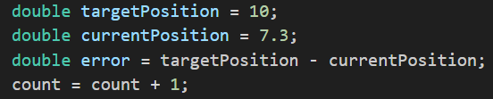
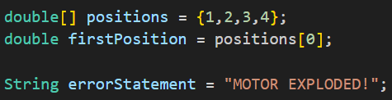
Java Basics
Strongly typed languages
  Declare the type of a new variable
  Semicolon (;) ends the line of code
Manipulate variables
  Add, subtract, divide, multiple, etc…
Compare two variables
Non-Primitive Types
  Array
  String
  Enum

Slide 16
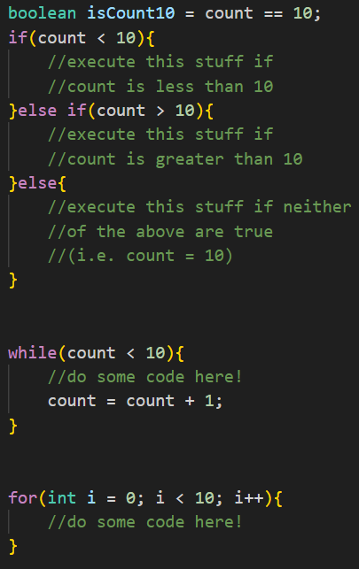
Java Basics
Control flow
  Code executes from top to bottom
  Manipulate the flow of code with logic
If statements
  Branching statements based on a condition
  Code within the {} is executed
While/For loops
  Iterative loops until a condition is met
Switch statements
  Branching statement based on the state of a variable

Slide 17
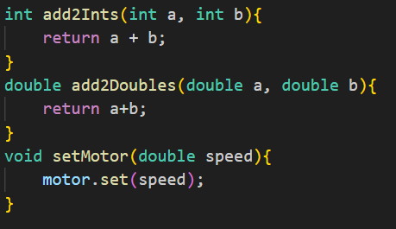
Java Basics
Methods/Functions
  Abstract code snippets
  Reusable snippets of code
Return Types
  Specify the variable being returned by a function

Slide 18
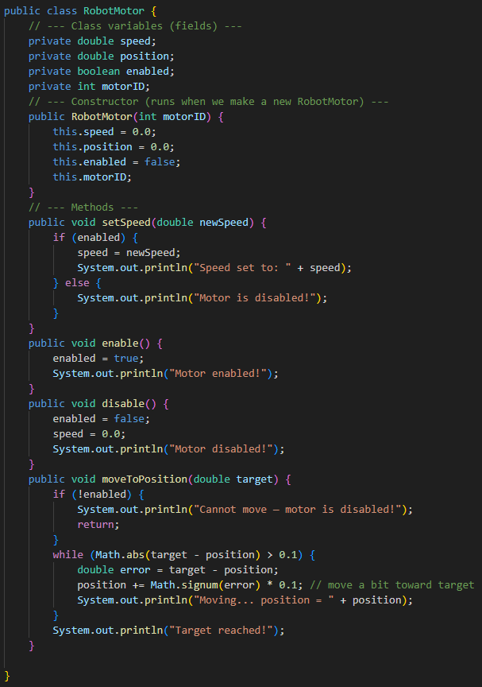
Java Basics
Classes
  Blueprints for custom objects
  Constructor
    Function that runs when a new instance of that class is created
    Defining function
Create custom classes
  Java requires that each custom class is given its own file
  Public vs Private
Load in classes from libraries

Slide 19
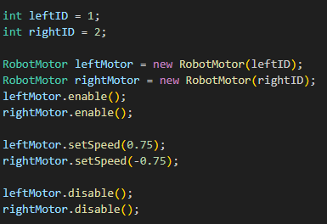
Java Basics
Instantiating a new object
  “new” keyword needed whenever you create a new object
  Non-objects don’t need the new keyword
“leftMotor” and “rightMotor” are different variables built from the same blueprint
  Pass in variable constructor specific parameters when creating

Slide 20
FRC Programming
Setting up the IDE (Integrated Development Environment)
WPILib
Structure of a FRC Java Program
Timed vs Command-based programming
Building a basic Teleop program

Slide 21
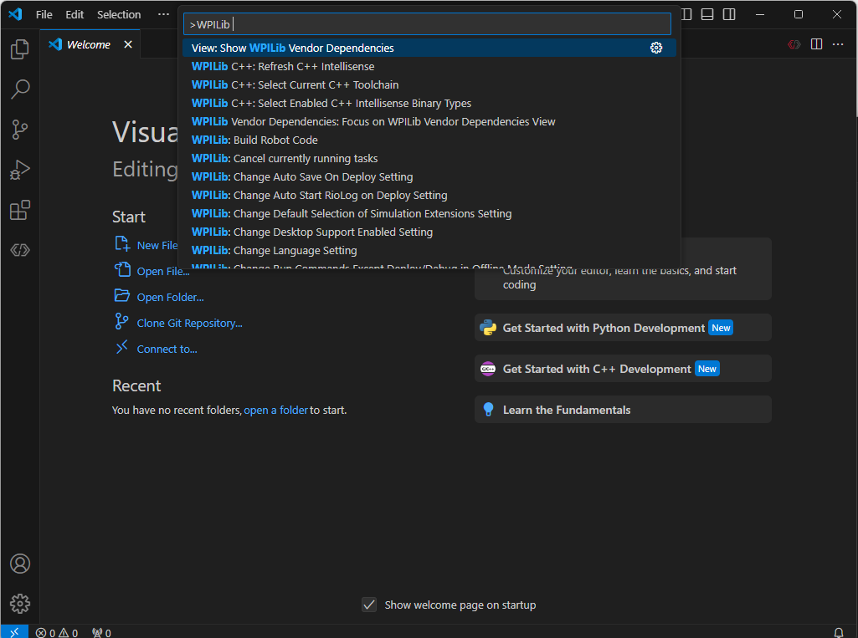
FRC Programming
Programming with Java in FRC is done in the WPILib development environment
  Visual Studio Code
WPILib Command Palette
  Create new projects
  Deploy and build code

Slide 22
WPILib
WPI Robotics Library
  Standard software library for FRC Robotics
  Java, C++, Python
Contains a bunch of useful classes and subroutines for FRC programming
  Controllers
  Drivetrains
  Vision pipelines
  Unit conversions
Useful utility applications
  SmartDashBoard/Shuffleboard
  PathWeaver

Slide 23
FRC Programming
“Create New Project” from the WPILib command palette
  Template
    Timed or Command
  Project location and name
  Team number
Robot Generated structure
  Gradle files
    System build files (dependencies and deploy commands)
  Actual code lives in the src\main\java\frc\robot folder
    Main.java: Program launch file, rarely modified
    Robot.java: Entry point for robot logic, main programming file

Slide 24
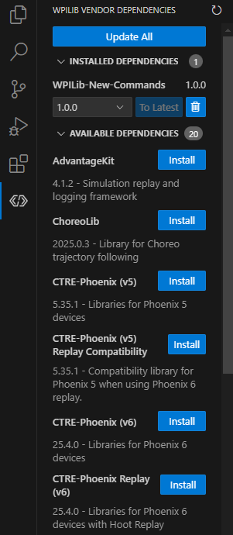
FRC Programming
Installing third party libraries
Code built specifically for certain hardware
  Cross The Road Electronics
  Rev
  LimeLight
  PathPlanner

Slide 25
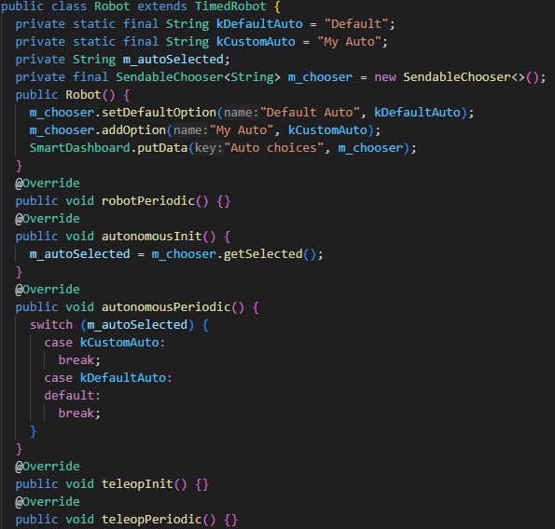
Timed-Based Programming
All code is contained in one file
  Robot.java
Manual control of inputs/outputs
  Direct control of motors
  Mapping joysticks to drivetrains
Great for simple setups
  Can become quickly messy for more advanced systems
One function for each stage of the match
  Loops at a frequency of 50 hz (code runs 50 times a second)
    DO NOT PROGRAM WITH WHILE/FOR LOOPS!!

Slide 26
Timed-Based Programming
Creating a basic Teleop code in Timed-Based programming
  Tank/Arcade drive
  Simple joystick input

Slide 27
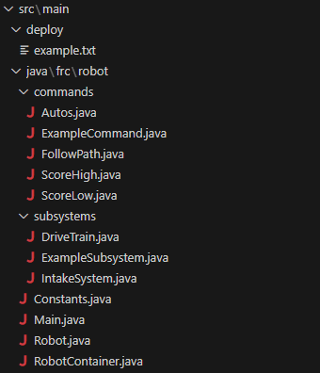
Command-Based Programming
Keeps code organized and modular by splitting code into three main components
  Subsystems: main hardware components of the robot
    Drivetrain, Elevator, IntakeSystem, Vision
  Commands: actions which tell the subsystems what to do
    Drive, FollowPath, ScoreHigh, Intake
  RobotContainer: main logic that wires everything together

Slide 28
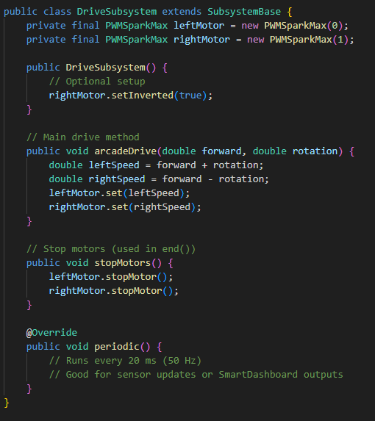
Command-Based Programming
Subsystems make up the core hardware components
Class-based
  Class variables
  Class methods
periodic function
  Inherited function which runs at 50 hz
  Each subsystem will run their periodic functions regardless of match stage
  Updating sensors or Logging

Slide 29
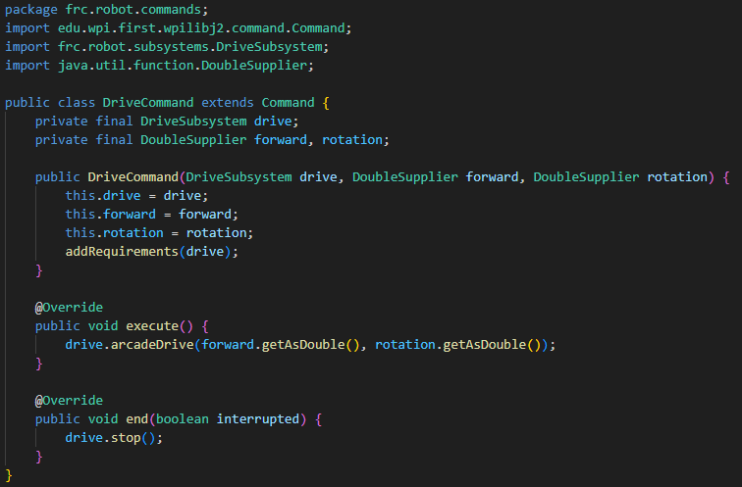
Command-Based Programming
Command Scheduler
  Subsystem dependencies
    Ensures no two commands use the same subsystem at once
  Command lifecycles
Commands tell the subsystem to perform actions
  initialize()
  execute()
  isfinished()
  end()
Default command is run whenever no other command is scheduled
  Teleop drive with joystick

Slide 30

Command-Based Programming
Command-based programming has a high skill ceiling
Greatly enhances autonomous capabilities
Paradigm creates cleaner code which makes for easier advanced controls
Lots of considerations
  Subsystem dependencies
  Command groups
  Scheduling issues
  Conditional commands

Slide 31
Command-Based Programming
Creating a basic Command-based Teleop program
  Tank/Arcade drive
  Simple joystick input

